Slide 1
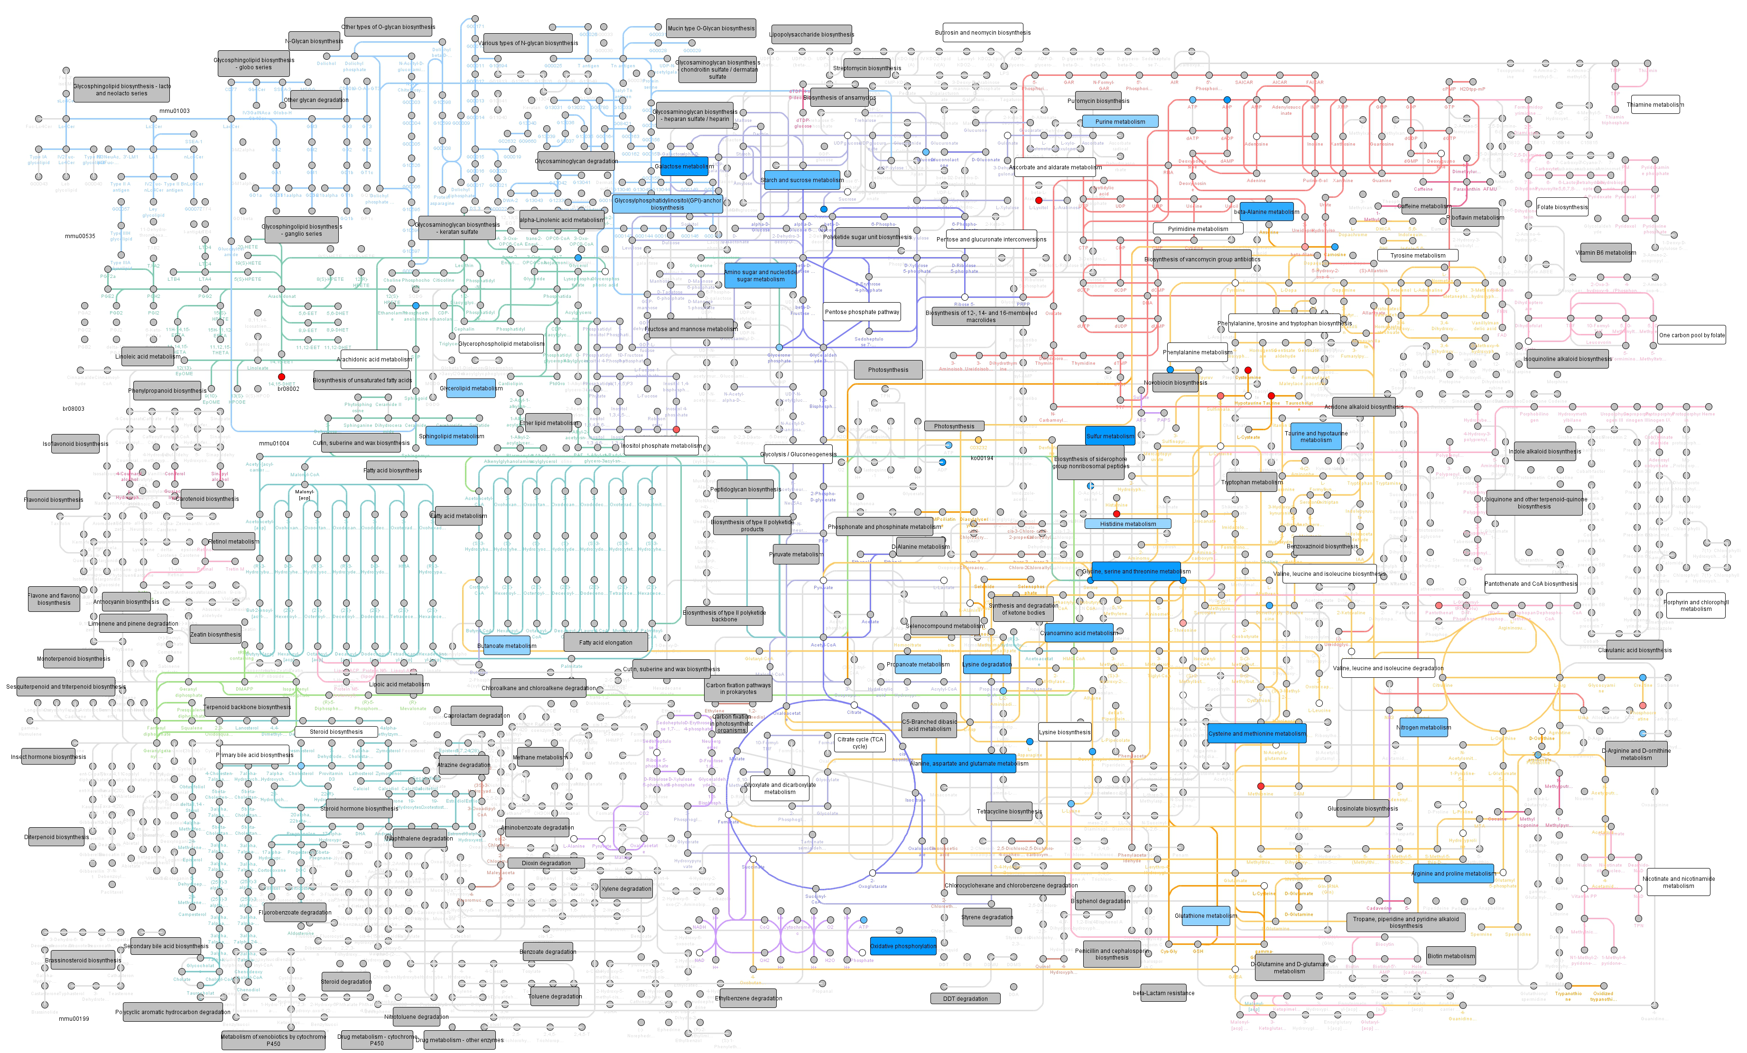
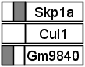
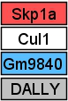
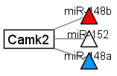
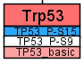
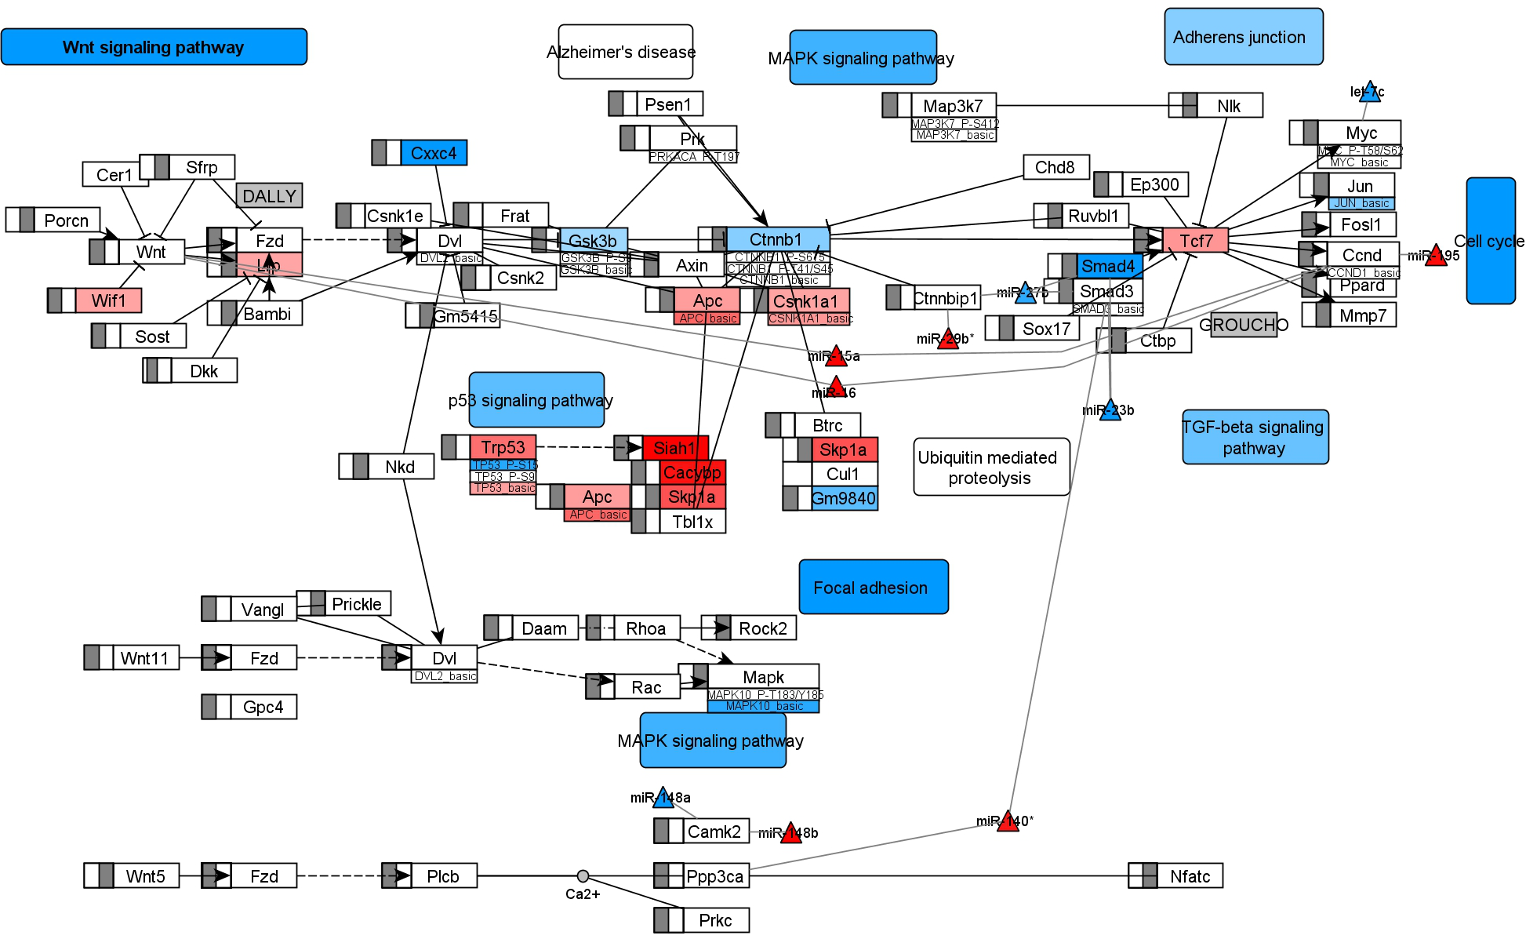
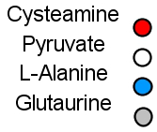
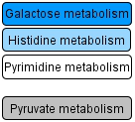
A
C
Data types
DNAm
mRNA
miRNA
Protein modification
Metabolite
Pathway
Color keys
hypermethylated
no difference
hypomethylated
upregulated
no difference
downregulated
no data
mRNA target
same colors as mRNA
same colors as mRNA
B
Taurine
Pyruvate
L-Alanine
Acetate
same colors as mRNA
high significance
small significance
non significant
contains no significant feature
log₂ fold change (e.g. Metabolite)
-1.5
0
1.5
p-value (e.g. Pathway)
0.0005
0.05

